Slide 1

TOEFL® Test Prep
By Arches Educational Services www.archeslanguageschool.com
Session 1: Getting Familiar with the TOEFL® IBT Test
Adapted From: The Official Guide to the TOEFL® Test
(Fifth Edition)
By ETS® TOEFL

Slide 2
Session Aim
By the end of this TOEFL® test prep session, you should be familiar with some important information about the TOEFL iBT® test, such as:
the test purpose
the test scores
the test administration
the test format
the test length
the test scope

Slide 3
1. Why am I required to take the TOEFL® IBT Test?
If your first or native language is not English, it is likely that the college or university that you wish to attend will require you to take an English-language proficiency test.
The TOEFL iBT® test gives test takers the opportunity to prove that they can communicate ideas effectively in English in an academic setting by simulating university classroom and student life communication.

Slide 4
The language used in the test reflects real-life English language usage in university lectures, classes, and laboratories. It is the same language professors use when they discuss course work or concepts with students, or students use in study groups and everyday university situations.
In the past, English instruction focused on learning about the language (especially grammar), and students could receive high scores on tests without being able to communicate. Now teachers and learners understand the importance of using English to communicate.

Slide 5
2. Is There a Minimum Acceptable Score?
Each institution that uses TOEFL iBT® scores sets its own minimum level of accept-able performance. These minimums vary from one institution to another, depending on factors such as the applicant’s field of study, the level of study (undergraduate or graduate), or whether the institution offers English as a Second Language support for its students. Your test scores will be considered together with other information you supply to the institution to determine if you have the appropriate academic and language background to be admitted to a regular or modified program of study. They will also be reported to you both online and by mail.

Slide 6
3. What are the abilities measured?
The TOEFL iBT® test measures all four language skills that are important for effective communication:
Speaking
Listening
Reading
Writing

Slide 7
4. How is each ability measured?
The TOEFL® test reflects how language is really used with integrated tasks that combine more than one skill, just as in real academic settings. For example, the integrated questions ask test takers to:
listen and then speak in response to a question,
read, listen, and then speak in response to a question,
read, listen, and then write in response to a question.
This integration of skills represents the best practices in language learning and teaching. Activities that integrate language skills are nowadays popular in many English language programs.

Slide 8
4. How is the Test Administered?
The TOEFL iBT® test is administered via the Internet at a secure network of testing centers around the world.
Instructions for answering questions are given with each section. There is no computer tutorial. Test takers can take notes throughout the entire test; but at the end of testing, all notes are collected and destroyed at the test center to ensure test security.
For the Speaking section, test takers wear noise-canceling headphones and speak into a microphone. Responses are recorded digitally. For the Writing section, test takers type their responses.

Slide 9
There is an on-screen toolbar in each section that allows you to navigate through the test with ease. The section is always listed in the upper left-hand corner of the toolbar. For example, this is what the toolbar looks like in the listening and reading sections respectively:

Slide 10
Through the tool bar, you will always know what question you are on and how much time is remaining in the section. It is possible to hide the clock at any time by clicking on Hide Time.
Volume allows you to adjust the volume as you listen.
Help allows you to get relevant help. When you use the Help feature, the clock does not stop.
Next allows you to proceed to the next question.
Once you click on Next, you can confirm your answers by clicking on OK.

Slide 11
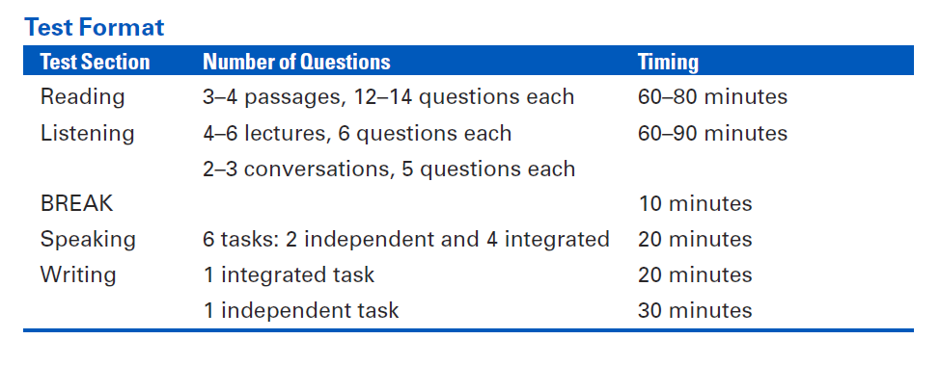
5. How long is the test?
The entire test is about four hours long, and all sections are taken on the same day. The following chart shows the possible number of questions and the timing for each section.

Slide 12
Conclusions
Undergraduate, graduate, and postgraduate programs around the world require students to demonstrate their ability to communicate in English as an entrance requirement.
The TOEFL® test measures how well test takers use English, not just their knowledge of the language. Because it is a valid and reliable test with unbiased, objective scoring, the TOEFL test confirms that a student has the English language skills necessary to succeed in an academic setting.

